Slide 1
Neural Networks – Hyperparameter optimisation
Finding the optimal optimiser

Slide 2
Network Hyperparameters
Number of layers (usually 2 for an RNN)
Number of neurons per layer (symmetric or asymmetric)
Activation functions
Node/arc weightings
Learning rate
Number of Epochs
Batch size
Context specific variables
Optimising these parameters ensures the neural network is optimal.
Activation functions: sigmoid or tanh, both suffer from vanishing gradient problem. ReLU, linear above 0.
Project Aim: Investigate different Hyperparameter Optimisation techniques and evaluate their performance in a biological process context. This will enable us to identify which Optimisers work best for bio-chemical engineering applications.

Slide 3
Shortlist of Optimisers
From initial research and review of the literature, a shortlist was drawn of different Optimiser methods.
Baseline methods – Grid & Random search
Bayesian Optimisation - Gaussian Processes (GP). - Tree-structured (Adaptive) Parzen Estimator (TPE). - Random Forests.
Population/evolutionary methods
It is clear from literature that Grid < Random < GP < TPE. The more interesting comparisons will be between GP/TPE and the evolutionary genetic algorithms (and others I haven’t researched properly yet).

Slide 4
Plan
Pick a neural network and standardise it’s I/O stream
Implement Grid search, random search and Gaussian Process Bayesian optimisation algorithms, ensuring python modules with standardised I/O.
Create an interface to swap between hyperparameter optimisers modules and different neural networks modules.
Look at creating more optimiser modules.
Look at more advanced Neural networks
Do a full investigation and ranking of the different optimisers.
Testing data
Evaluation of previous iteration
Training data and hyperparameter list
Chosen neural network
Optimiser method
Current hyperparameter
solution
Chosen neural network
Optimal
solution
Main interface for training procedure

Slide 5
Week 1
Previously, read up on literature and became familiar with neural net code provided.
Officially started on 29th June 2020. Spent the week developing some crude python scripts to investigate the performance of Grid and Random search.
I am currently using the same data and pre-processing created by Mostafizor Rahman for his thesis work into Neural Networks.
These scripts will later be formed into standalone modules and integrated into an over-arching “Optimiser-to-Network Interface”.

Slide 6
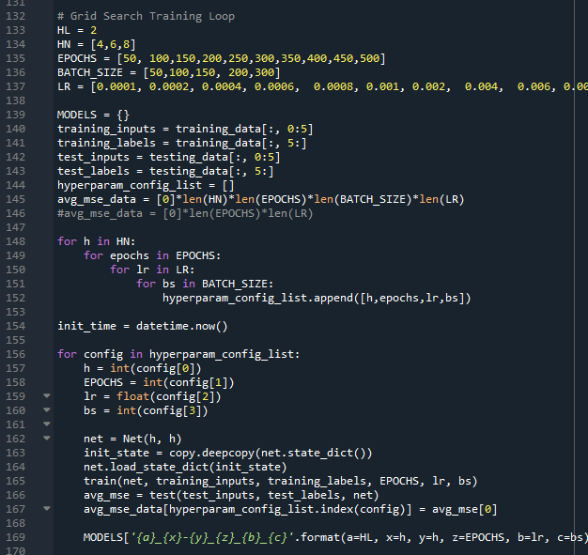
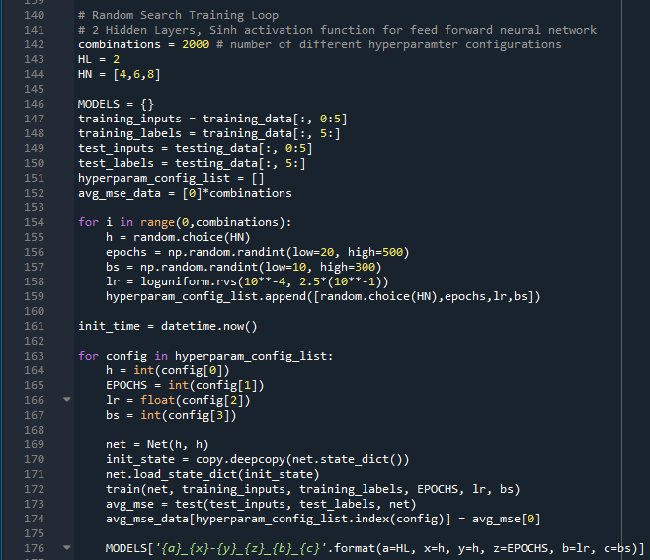
HPO_grid_search.py
HPO_random_search.py

Slide 7
Grid search
Random search
HN = [4,8]
EPOCHS = [50, 100, 150, 200, 300]
BATCH_SIZE = [60,100]
LR = 10 values equally spaced from 0.0002 to 0.020
Grid search algorithm execution time: 0:38:53.953573 (hrs:mins:secs)
No. of parameter configurations: 200
1 ) Params: HN = 8 Epochs = 100 LR = 0.008 Batch Size = 100
MSE: 0.003322…
2 ) Params: HN = 8 Epochs = 50 LR = 0.018 Batch Size = 100
MSE: 0.003908…
3 ) Params: HN = 8 Epochs = 100 LR = 0.012 Batch Size = 100
MSE: 0.004047…
4 ) Params: HN = 8 Epochs = 150 LR = 0.01 Batch Size = 100
MSE: 0.004096…
Random uniform distributions were used for EPOCHS, Batch Size and LR. HN = [4,8] (randomly selected) EPOCHS from 1 to 500 BATCH_SIZE from 1 to 300 LR from 0.0001 to 0.1 Note, the ranges used mean random search had more computation from larger epoch values which take more time to train. Random search algorithm execution time: 1:12:08.963038 (hrs:mins:secs)
No. of parameter configurations: 200
1 ) Params: HN = 4 Epochs = 270 LR = 0.0647765… Batch Size = 49
MSE: 0.004256…
2 ) Params: HN = 8 Epochs = 86 LR = 0.06869176… Batch Size = 282
MSE: 0.004329…
3 ) Params: HN = 8 Epochs = 95 LR = 0.09231202… Batch Size = 150
MSE: 0.004899…
4 ) Params: HN = 8 Epochs = 231 LR = 0.00911087… Batch Size = 242
MSE: 0.004946…
Grid search outperformed random search – However, domain spaces are not equivalent.

Slide 8
Grid search
Random search
Random uniform distributions were used for EPOCHS and Batch Size. A uniform logarithmic distribution was taken for LR. HN = [4,8] (randomly selected) EPOCHS from 20 to 500 BATCH_SIZE from 10 to 300 LR from 0.0001 to 0.20 Random search algorithm execution time: 0:44:50.54 (hrs:mins:secs)
No. of parameter configurations: 200
1 ) Params: HN = 8 Epochs = 72 LR = 0.01746… Batch Size = 215
MSE: 0.004604…
2 ) Params: HN = 8 Epochs = 79 LR = 0.008759… Batch Size = 214
MSE: 0.004694…
3 ) Params: HN = 4 Epochs = 54 LR = 0.03934… Batch Size = 287
MSE: 0.004718…
4 ) Params: HN = 8 Epochs = 482 LR = 0.0004220… Batch Size = 277
MSE: 0.004970…
HN = [4,8]
EPOCHS = [100, 200, 300, 400, 500]
BATCH_SIZE = [50, 100, 200, 300]
LR = [0.002, 0.004, 0.02, 0.04, 0.1]
Grid search algorithm execution time: 0:49:25.28 (hrs:mins:secs)
No. of parameter configurations: 200
1 ) Params: HN = 4 Epochs = 500 LR = 0.004 Batch Size = 50
MSE: 0.004060…
2 ) Params: HN = 4 Epochs = 400 LR = 0.002 Batch Size = 50
MSE: 0.004304…
3 ) Params: HN = 4 Epochs = 500 LR = 0.004 Batch Size = 200
MSE: 0.004360…
4 ) Params: HN = 8 Epochs = 300 LR = 0.002 Batch Size = 300
MSE: 0.004405…
Grid search outperformed random search. Domain spaces more appropriate/equal. Need more parameter configurations?

Slide 9
Grid search
Random search
Random uniform distributions were used for EPOCHS and Batch Size. A uniform logarithmic distribution was taken for LR. HN = [4,6,8] (randomly selected) EPOCHS from 20 to 500 BATCH_SIZE from 10 to 300 LR from 0.0001 to 0.25 Random search algorithm execution time: 13:18:23 and 7:57:26 No. of parameter configurations: 3000 and 2000
3000 over 13:18:23
1 ) Params: HN = 8 Epochs = 152 LR = 0.003947… Batch Size = 104
MSE: 0.003672…
2 ) Params: HN = 6 Epochs = 379 LR = 0.0005412… Batch Size = 11
MSE: 0.003905…
2000 over 7:57:26
1 ) Params: HN = 6 Epochs = 402 LR = 0.0003725… Batch Size = 26
MSE: 0.004061…
2 ) Params: HN = 6 Epochs = 117 LR = 0.02716… Batch Size = 76
MSE: 0.004236…
HN = [4,6,8]
EPOCHS = [50, 100,150,200,250,300,350,400,450,500] BATCH_SIZE = [50,100,150, 200,300] LR = 20 manually selected values from 0.0001 to 0.25
Grid search algorithm execution time: 10:57:39 (hrs:mins:secs)
No. of parameter configurations: 3000
1 ) Params: HN = 4 Epochs = 150 LR = 0.01 Batch Size = 50
MSE: 0.003392…
2 ) Params: HN = 8 Epochs = 250 LR = 0.001 Batch Size = 50
MSE: 0.003953…
3 ) Params: HN = 8 Epochs = 450 LR = 0.0006 Batch Size = 50
MSE: 0.004010…
4 ) Params: HN = 6 Epochs = 200 LR = 0.001 Batch Size = 50
MSE: 0.004222…
Grid search outperformed random search ... Again. Need more sparse data.

Slide 10
Grid search
Random search
Random uniform distributions were used for EPOCHS and Batch Size. A uniform logarithmic distribution was taken for LR. HN = [4,6,8] (randomly selected) EPOCHS from 20 to 500 BATCH_SIZE from 10 to 300 LR from 0.0001 to 0.25 Random search algorithm execution time: 1:18:18.38 (hrs:mins:secs)
No. of parameter configurations: 288
1 ) Params: HN = 6 Epochs = 393 LR = 0.001177… Batch Size = 180
MSE: 0.003786…
2 ) Params: HN = 8 Epochs = 444 LR = 0.003883… Batch Size = 253
MSE: 0.004293…
3 ) Params: HN = 6 Epochs = 272 LR = 0.001067… Batch Size = 54
MSE: 0.004613…
4 ) Params: HN = 8 Epochs = 261 LR = 0.001275… Batch Size = 191
MSE: 0.004687…
HN = [4,8]
EPOCHS = [50,150,400, 500]
BATCH_SIZE = [50, 300, 400]
LR = [0.0001, 0.0004, 0.0008, 0.001, 0.004, 0.008, 0.01, 0.04, 0.08, 0.1, 0.2, 0.25]
Grid search algorithm execution time: 1:05:29.37 (hrs:mins:secs)
No. of parameter configurations: 288
1 ) Params: HN = 8 Epochs = 150 LR = 0.01 Batch Size = 300
MSE: 0.004023…
2 ) Params: HN = 4 Epochs = 400 LR = 0.001 Batch Size = 50
MSE: 0.004485…
3 ) Params: HN = 8 Epochs = 50 LR = 0.004 Batch Size = 50
MSE: 0.004568…
4 ) Params: HN = 4 Epochs = 500 LR = 0.001 Batch Size = 400
MSE: 0.004876…
Grid search outperformed random search ... And again

Slide 11
Grid search
Random search
HN: H1 = 4, H2 = 8 EPOCHS from 20 to 500 BATCH_SIZE = 300 LR from 0.0001 to 0.25 Random search algorithm execution time: 0:27:46.021268 (hrs:mins:secs)
No. of parameter configurations: 400
1 ) Params: HN = 6 Epochs = 296 LR = 0.007606 Batch Size = 300
MSE: 0.003713
2 ) Params: HN = 4 Epochs = 280 LR = 0.004261 Batch Size = 300
MSE: 0.003851
3 ) Params: HN = 6 Epochs = 266 LR = 0.005205 Batch Size = 300
MSE: 0.004444
4 ) Params: HN = 4 Epochs = 109 LR = 0.004678 Batch Size = 300
MSE: 0.004554
HN: H1 = 4, H2 = 8
EPOCHS = [30, 60, 90, 120, 150, 180, 210, 240, 270, 300, 330, 360, 390] BATCH_SIZE = 300
LR = 0.0001 to 0.0009, 0.001 to 0.009, 0.01 to 0.09, 0.1 to 0.25.
Grid search algorithm execution time: 0:29:17.470747 (hrs:mins:secs)
No. of parameter configurations: 403
1 ) Params: HN = (4,8), Epochs = 330 LR = 0.008 Batch Size = 300
MSE: 0.004054
2 ) Params: HN = (4,8), Epochs = 270 LR = 0.002 Batch Size = 300
MSE: 0.004475
3 ) Params: HN = (4,8), Epochs = 120 LR = 0.08 Batch Size = 300
MSE: 0.004626
4 ) Params: HN = (4,8), Epochs = 150 LR = 0.03 Batch Size = 300
MSE: 0.004649
This time, performances were similar. So … again.

Slide 12
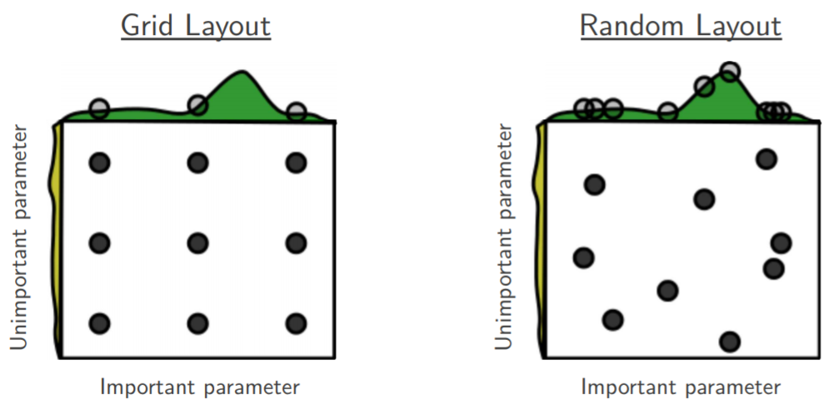
Grid search better than Random?
Random search has no improvement over grid search if the hyperparameter intervals are ‘saturated’.
Benefit of Random search only becomes available for extremely large data sets, well over 2000 combinations.
My current Random search algorithm changes the neural network each iterations whereas Grid retains the same network until all of it’s relevant configurations have been tested. However, this network initialisation time appears to be negligible after some crude tests.
Maybe my random sampling method is not erratic enough? np.random.uniform()

Slide 13

Gaussian Process Bayesian Optimisation
Attempting to make scripts via Python Package APIs. Difficult to implement with current form of neural network. Could either: Code the stats and algorithm from scratch. Find a neural network compatible with a package API (i.e. KERAS?).

